Slide 1
Binding Views and Handling Actions

Slide 2
Contents
Binding views
Handling actions
Common event listeners

Slide 3
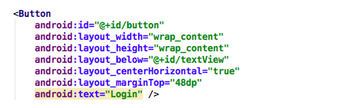
Binding View
Assign id for view in xml file

Slide 4
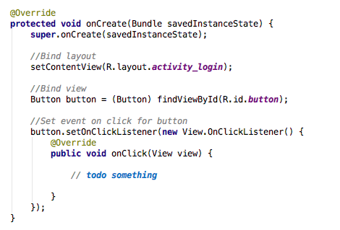
Binding View
Access view through findViewById()

Slide 5
Handling Action
An UI event is an action that is triggered by the user interacting with the UI
A button pressed or released
A key is pressed or released
An area of a touch screen is touched, etc.
Gesture
long touch
double-tap
Fling
Drag
Scroll
pinch

Slide 6
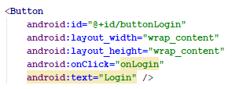
Handling Action – 1st way
Set event name in xml file: android:onClick=”EventName“

Slide 7
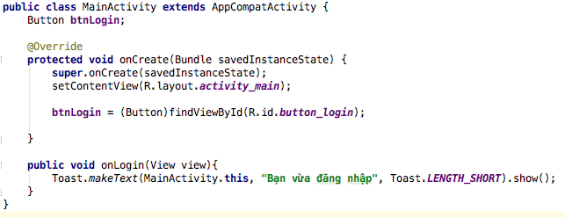
Handling Action – 1st way
In activity, implement event

Slide 8
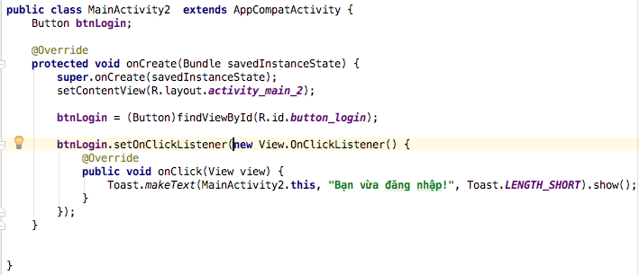
Handling Action – 2nd way
Inline anonymous listener

Slide 9
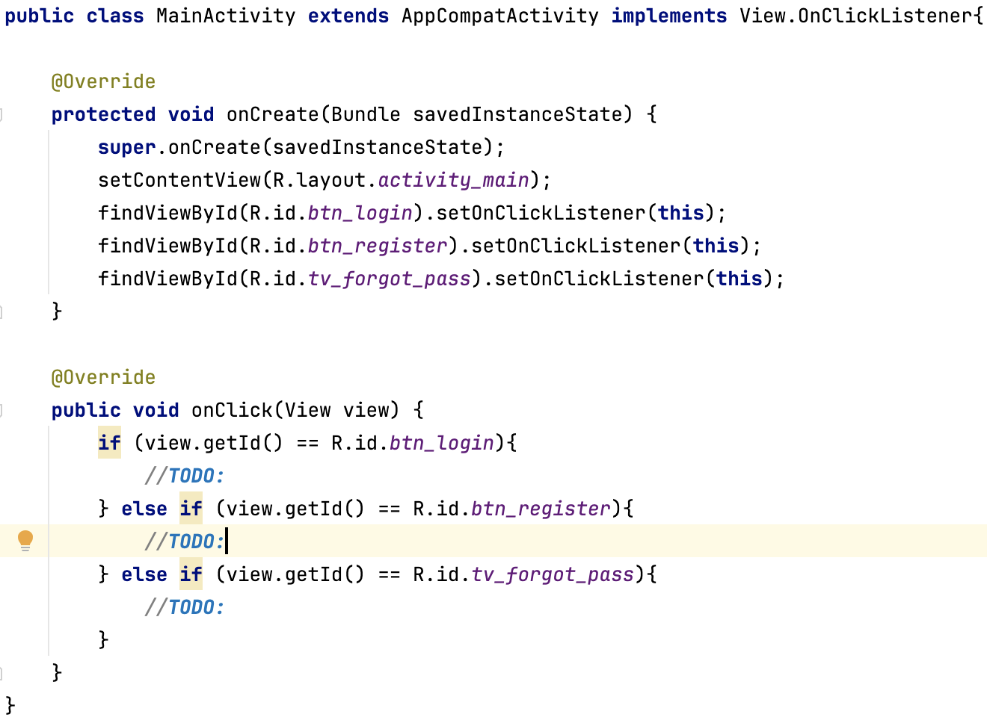
Handling Action – 3th way
- Activity implements View.OnclickListener

Slide 10
View is base class for input controls
The View class is the basic building block for all UI components, including input controls
View is the base class for classes that provide interactive UI components
View provides basic interaction through android:onClick

Slide 11
View Event listeners
setOnClickListener - Callback when the view is clicked
setOnDragListener - Callback when the view is dragged
setOnFocusChangeListener - Callback when the view changes focus
setOnGenericMotionListener - Callback for arbitrary gestures
setOnHoverListener - Callback for hovering over the view
setOnKeyListener - Callback for pressing a hardware key when view has focus
setOnLongClickListener - Callback for pressing and holding a view
setOnTouchListener - Callback for touching down or up on a view

Slide 12
AdapterView Event Listeners
setOnItemClickListener - Callback when an item contained is clicked
setOnItemLongClickListener - Callback when an item contained is clicked and held
setOnItemSelectedListener - Callback when an item is selected

Slide 13
EditText Common Listeners
addTextChangedListener - Fires each time the text in the field is being changed
setOnEditorActionListener - Fires when an "action" button on the soft keyboard is pressed

Slide 14
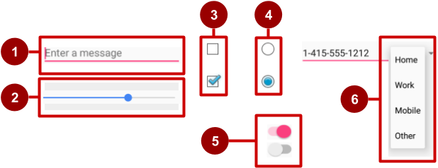
Examples of input controls
EditText
SeekBar
CheckBox
RadioButton
Switch
Spinner

Slide 15
How input controls work
Use EditText for entering text using keyboard
Use SeekBar for sliding left or right to a setting
Combine CheckBox elements for choosing more than one option
Combine RadioButton elements into RadioGroup — user makes only one choice
Use Switch for tapping on or off
Use Spinner for choosing a single item from a list

Slide 16
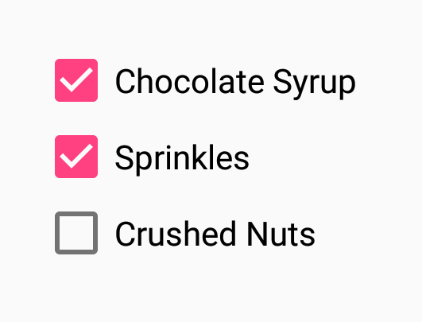
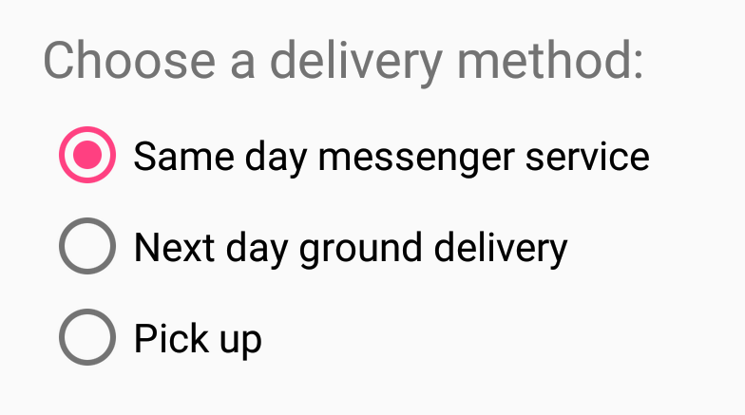

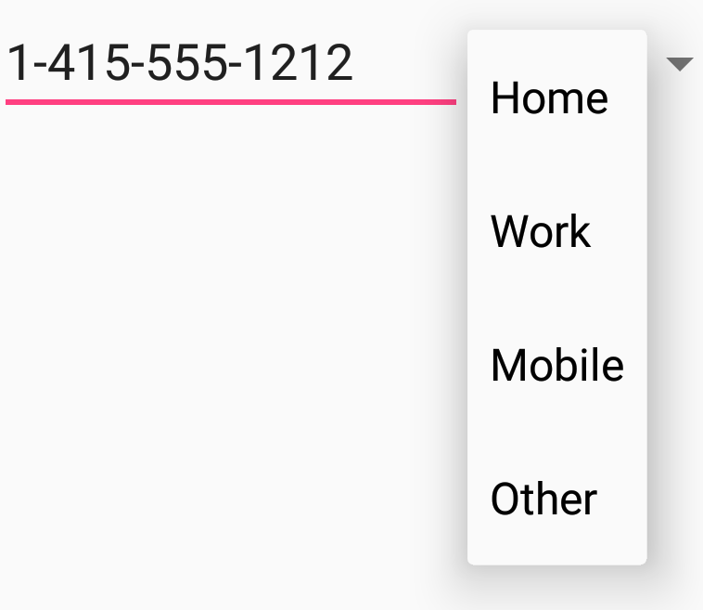

UI elements for providing choices
CheckBox and RadioButton
ToggleButton and Switch
Spinner

Slide 17
CheckBox
User can select any number of choices
Checking one box does not uncheck another
Users expect checkboxes in a vertical list
Commonly used with a Submit button
Every CheckBox is a View and can have an onClick handler

Slide 18
RadioButton
Put RadioButton elements in a RadioGroup in a vertical list (horizontally if labels are short)
User can select only one of the choices
Checking one unchecks all others in group
Each RadioButton can have onClick handler
Commonly used with a Submit button for the RadioGroup

Slide 19
Toggle buttons and switches
User can switch between on and off
Use android:onClick for click handler
Toggle buttons
Switches

Slide 20
Classwork
On Login screen, when click Login button:
If username is admin and password is 123456 => show “Login successfully”
Otherwise, show “Login failed”

Slide 21
References
https://google-developer-training.github.io/android-developer-fundamentals-course-concepts-v2/

